Slide 1
Team 87 Group Project Presentation
Ashritha Shivakumaraswamy (as6601)
David Zhang (hz2811)
Kara Jiwachotkamjon (kj2545)
Zichen Wang(zw2913)

Slide 2
Executive Summary
EDA and Visualization
Data Preparation
Algorithm Development
Explored data pattern from left and right data set, leveraging venn-diagram to represent the initial match data across tables
Identify unique data amount in each column to decide which ones to include when computing confidence score.
Examine similarity between variables from left and right dataset
Drop unnecessary columns to reduce data size
Rename matching columns to allow merge for later algorithm
Remove special characters, NA/missing values and set all strings to lowercase for both datasets.
JW-Similarity(character comparison)
Fuzzy-Wuzzy(String preprocessing)

Slide 3
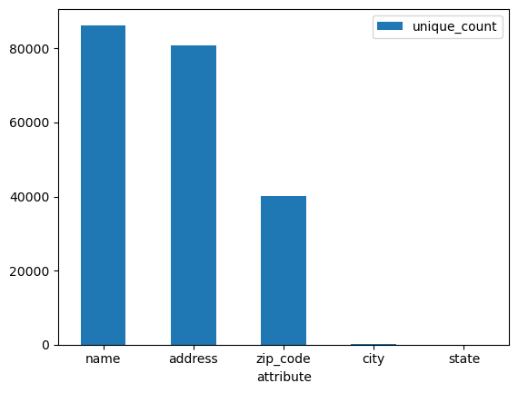
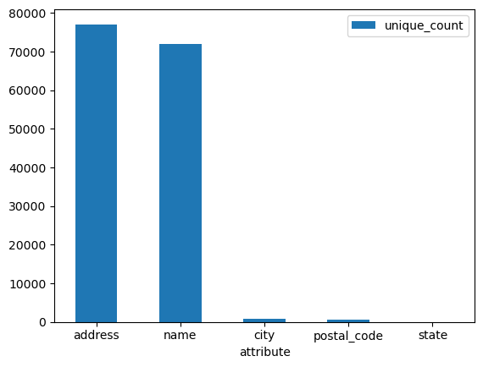
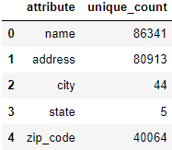
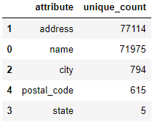
Exploratory Data Analysis (1/2)
Left Data Set
Right Data Set
Based on the unique count of each attribute between 2 data set, Left data set seems to have larger data compared to the Right data set. In addition, the Name and Address contributed to the largest between 2 groups. However, Zip_code in the Left data set displays a significant unique count of ~40k compared to the Right data set of only ~600.

Slide 4
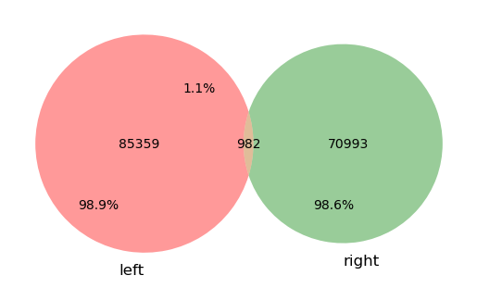
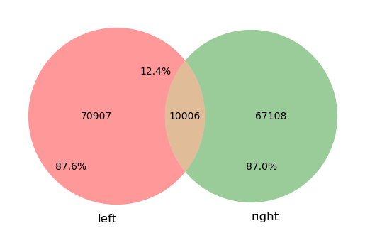
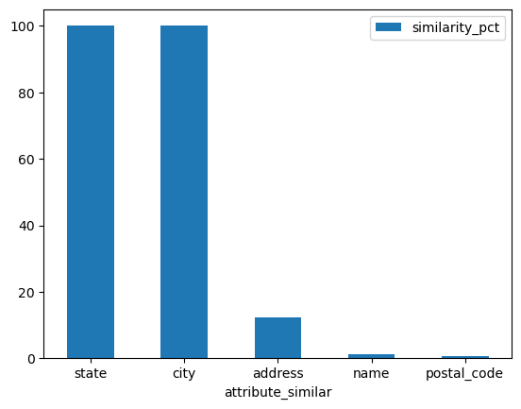
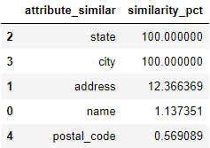
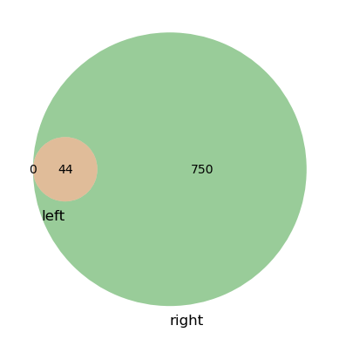
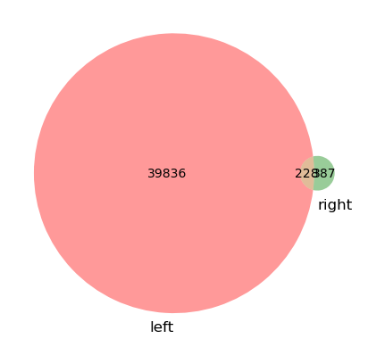
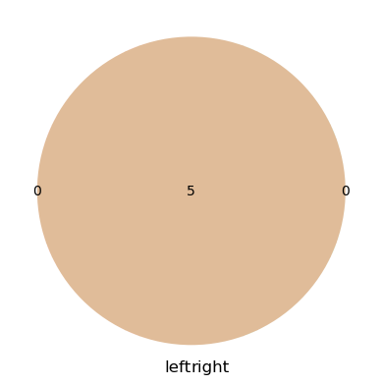
Exploratory Data Analysis (2/2)
Example of Venn-diagram visualization
Similarity Percentage Summary
Name Attribute Similarity
Address Attribute Similarity
City Attribute Similarity
Zip code Attribute Similarity
State Attribute Similarity
Without any format adjustments other than lower case, State and City attributes are the only attributes with 100% matches, while Address, Name and Postal code are the lowest matches.

Slide 5
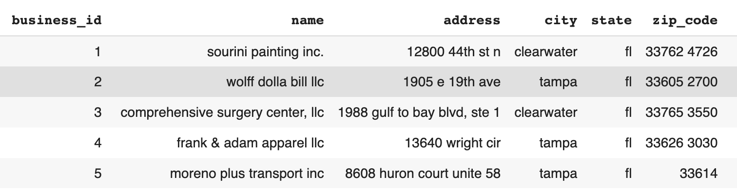
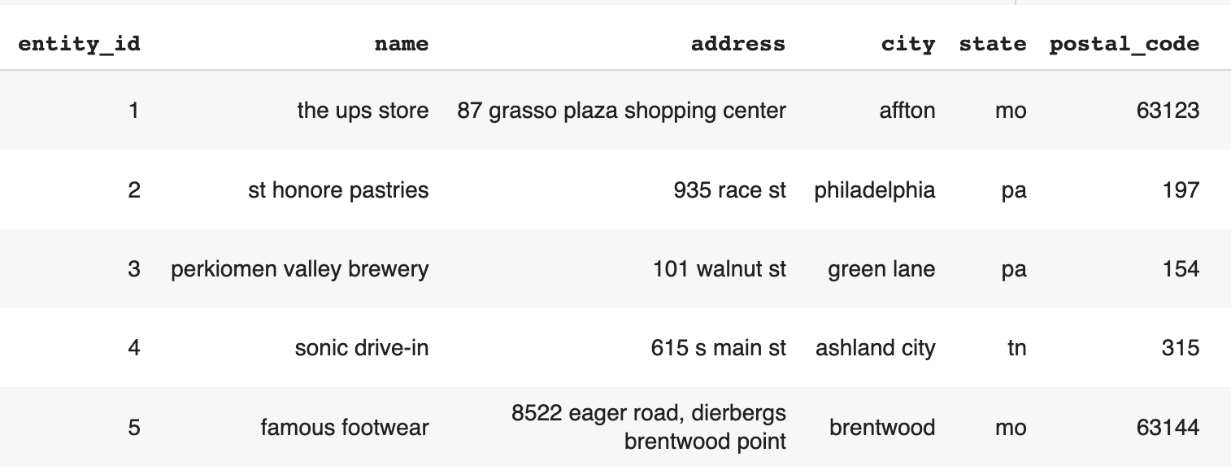
Data preparation/cleaning
-Remove unnecessary columns including size, categories
-Rename ID columns from both datasets to allow merging
-Formatting data for algorithm by removing special characters and set all strings to lowercase.

Slide 6
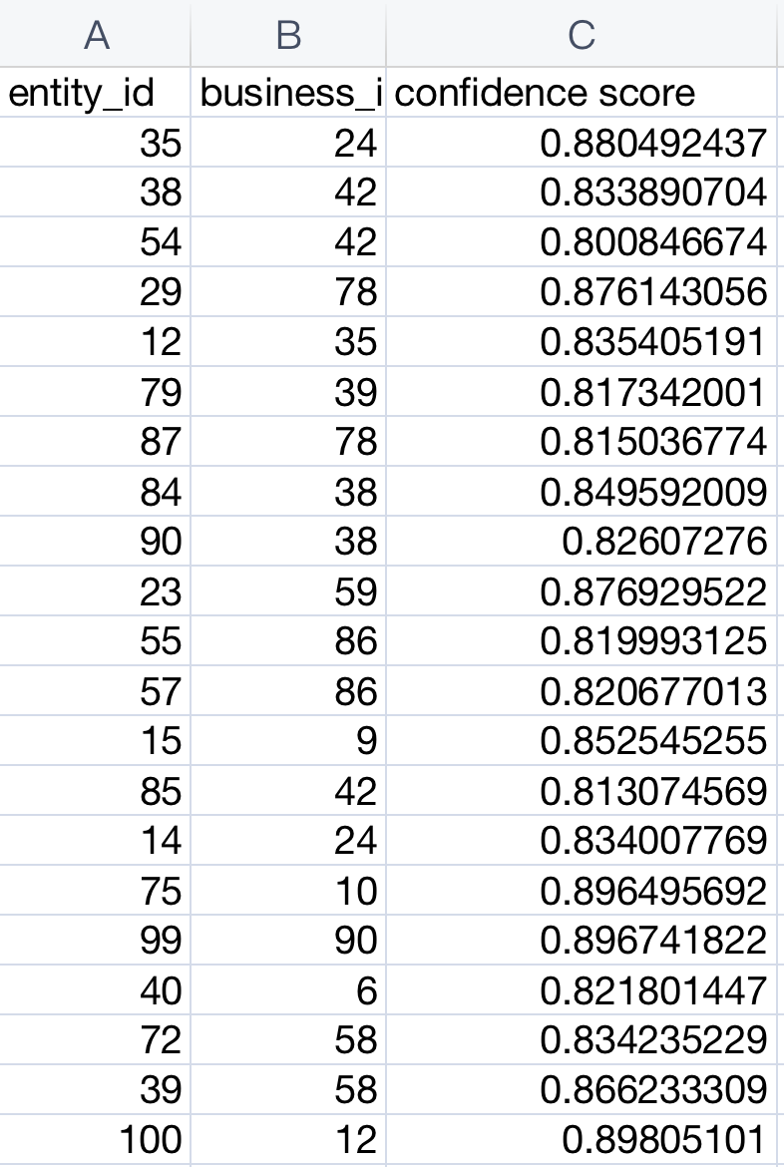
Algorithm Explanation and Confidence score
Jaro-Winkler Similarity
Similarity Metrics: Jaro Distance
Techniques: Character comparison - Transposition detection - Common prefix bonus
Pros: Good performance on large datasets & Suitable for fuzzy matching tasks
Cons: Limited to string comparisons & Sensitivity to variations in string length
FuzzyWuzzy
Similarity Metrics: Levenshtein Distance
Techniques: Preprocessing of strings - Scoring of similarity metrics - Selection of matching algorithm
Pros: Flexible and customizable & Can handle multiple similarity metrics
Cons: Slower performance compared to Jaro-Winkler & sensitive to choice of similarity metrics

Slide 7
Thank You

